Slide 1

An Overview
Of The ePNPlugIn v3
for QuickBooks®
Kris Brown
Sales Channel Development Manager
800-296-4810, x.152#
kbrown@eProcessingNetwork.Com

Slide 2
Why are PlugIns so popular…
The huge number of QuickBooks™ users
Total QB units sold in FY 2010: 1,669,000
Total Merchant Account Services customers: 316,000
QB has a 93% market share in retail solutions according to an NPD Group Monthly Retail Software report
QuickBooks (Financial Management Solutions) represents about 25% of Intuit’s annual revenue
IMS, ECHO, and QB POS (Payment Solutions) represents about 21% of Intuit’s annual revenue
Intuit also owns: Innovative Merchant Services, Electronic Clearing House, Quicken, TurboTax, Digital Insight, several payroll applications, and more
Many merchants think QB Merchant Services is “only option” or the “easy option”
However, the fees they charge are out of this world!
Intuit’s Quarterly Results: Q3 FY11 Fact Sheet

Slide 3
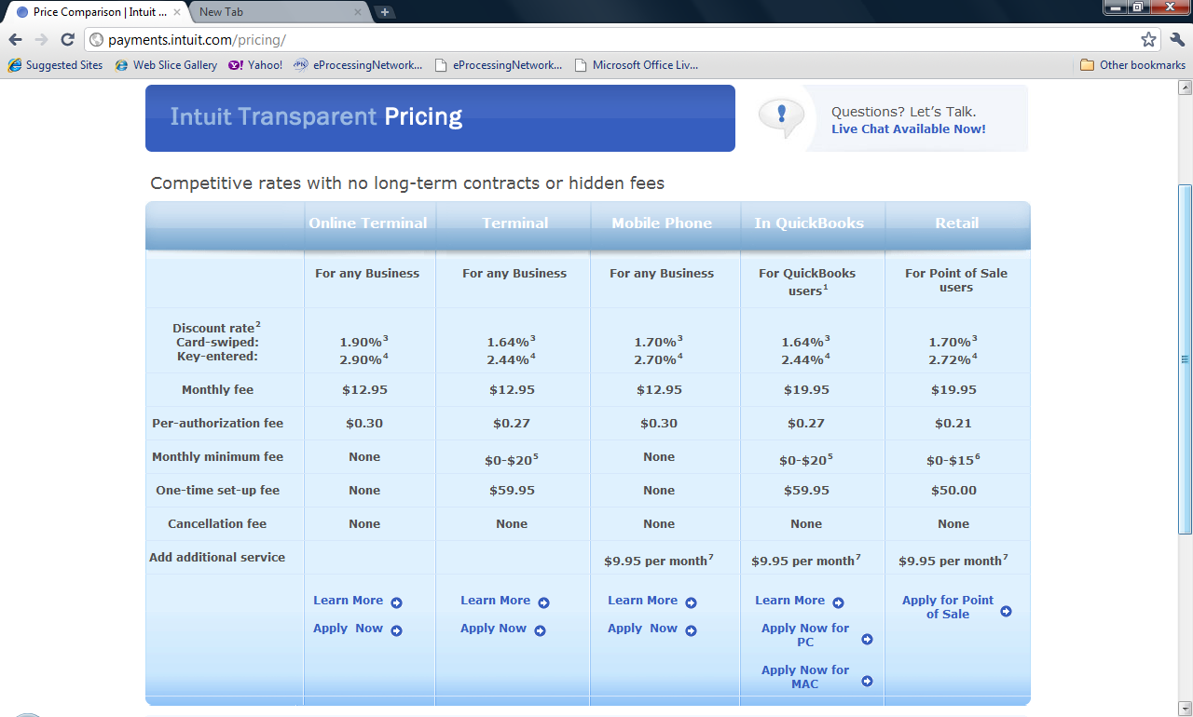
⁵ This applies only if you incur less than $20 in processing fees (discount rate and authorization fees) in a month.
Source: http://payments.intuit.com/pricing/

Slide 4
How can you compete w/ QB Merchant Services?
Price – That’s You
Service – That’s Us
PlugIn Features
  Must integrate with QB customer files (Many only allow batch downloads at the end of the day)
  Support card swipe, check, gift card, and cash processing

Slide 5



Compatible with:
PRO – PREMIER – ENTERPRISE
2006 thru 2011
Not Compatible with:
POS - Mac – Online - POS
Three main functions:
In real time - apply credit card, check, and gift card payments to invoices/sales receipts
Next day – batch download transactions to apply to customer invoices/sr
Upload open invoices to ePNBillPay
*Online Demo at: http://www.epnreseller.com/present/index.htm

Slide 6
1. Acquire Merchant Account
2. Board Merchant on ePN:
Online Terminal Only account OR
Internet Basic Account
3. Purchase ePNPlugIn software license
4. Merchant downloads ePNPlugIn from the
ePN Merchant Support Center.

Slide 7
Merchant Notification
Dear Merchant, This email is to notify you that ePNPlugIn for QuickBooks has been added to your account with eProcessing Network. The current version is available for the QuickBooks 2006-2010 Pro Premier and Enterprise versions only. Please contact tech support for more information about older version of QuickBooks.
BACK UP YOUR QUICKBOOKS FILE BEFORE DOWNLOADING!!!!
Quick Install Guide for Vista/Windows 7 Users: http://www.eprocessingnetwork.com/ePNPlugIn/ePNPluginQuickInstall.pdf
Quick Install Guide for Windows XP Users: http://www.eprocessingnetwork.com/ePNPlugIn/ePNPluginQuickInstallXP.pdf
The Quick User guide will be placed on your Desktop as a PDF file. This documentation will show you how to process transactions
and returns with ease. Detailed User Guide for the ePNPlugIn: http://www.eprocessingnetwork.com/docs/ePNPlugInUsersGuide.pdf
PLEASE READ THE INSTALL INSTRUCTIONS AND REQUIREMENTS BEFORE DOWNLOADING!!!!
To login and begin download
1. Login at www.eProcessingNetwork.com/MSCLogin.html
2. Enter your username and password.
3. If this is the first time logging in your account, you will need to change your password before proceeding.
4. Select the Resource option from the dropdown menu and click GO!
5. Scroll down to the ePNPlugIn Download button.

Slide 8
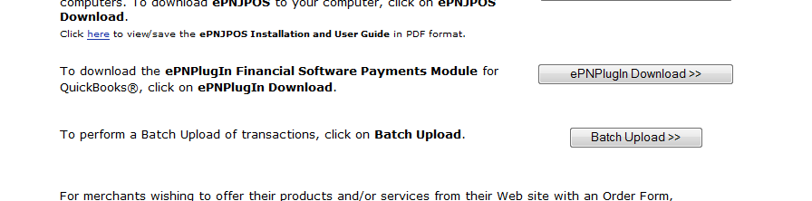
Installation is Easy!
Call merchant with Username & Password
Merchant logs into Merchant Support Center
From dropdown menu, select Resources, then select the ePNPlugIn Download>> button

Slide 9
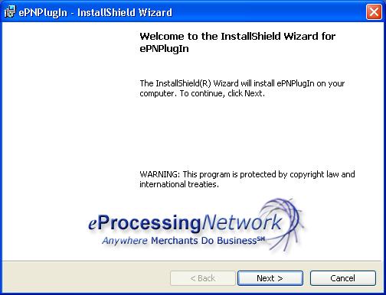
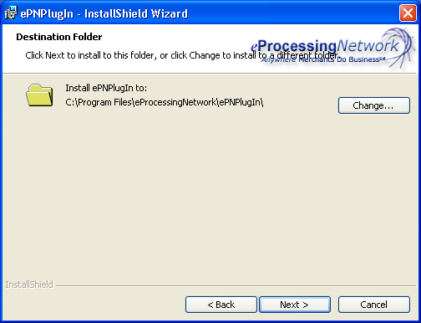
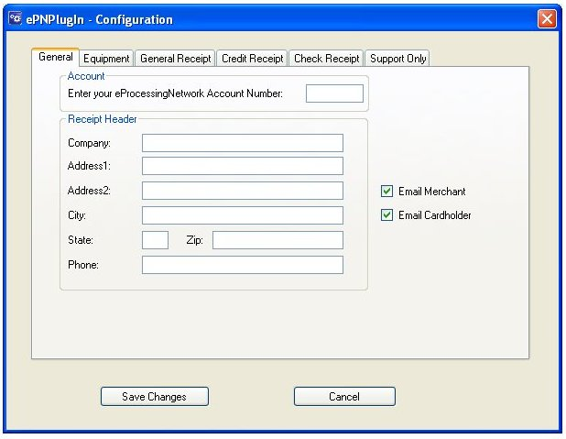
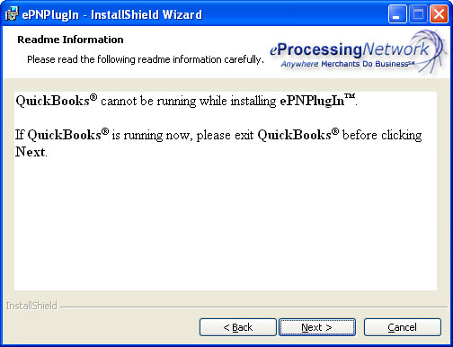
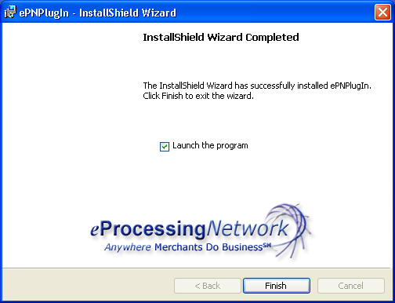
1
3
4
5
2

Slide 10
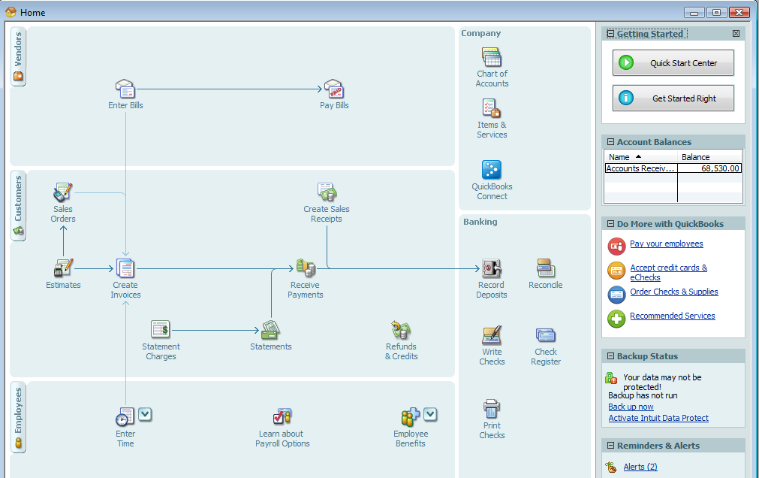
ePNPlugIn: Receive Payment
From the QuickBooks Home screen…
Select “Receive Payments”

Slide 11
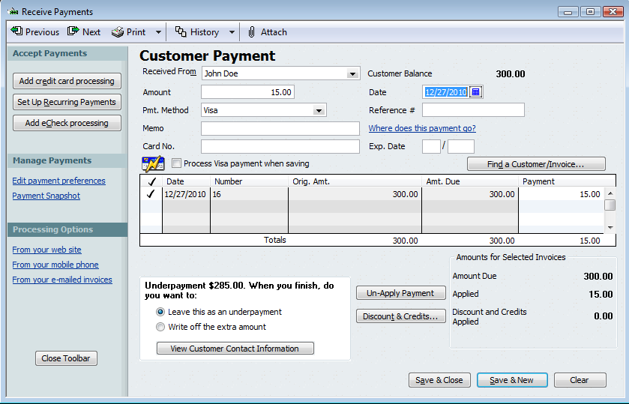
ePNPlugIn: Receive Payment
1. Select customer from customer list
2. Enter payment amount
3. Then “Save & Close”.

Slide 12
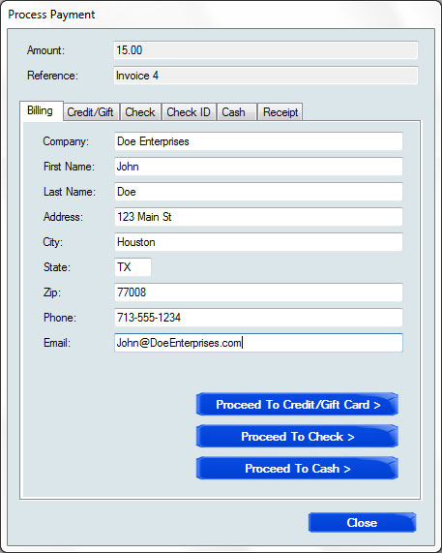
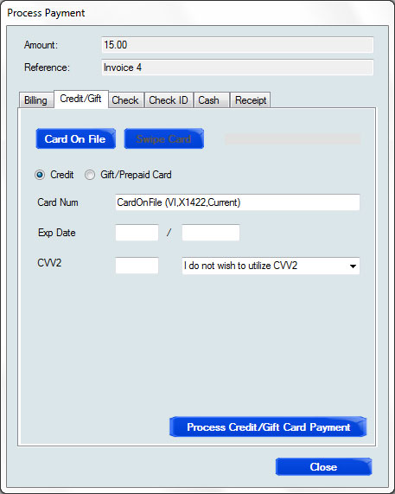
ePNPlugIn: Receive Payment
The ePN Process Payment window automatically comes up
{NOTE: It includes the amount, invoice #, and customer info from QB}
Select Credit/Gift, Check, or Cash payment
Manually key
Swipe card
Card On File

Slide 13
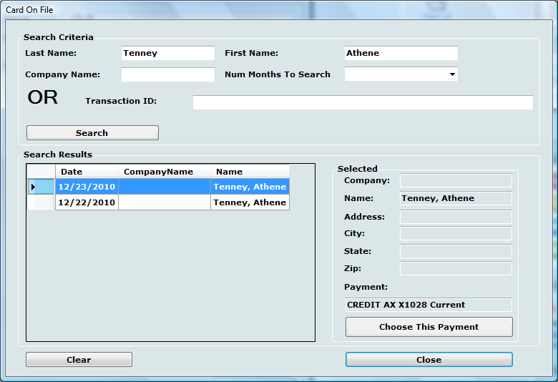
ePNPlugIn: Receive Payment

Slide 14
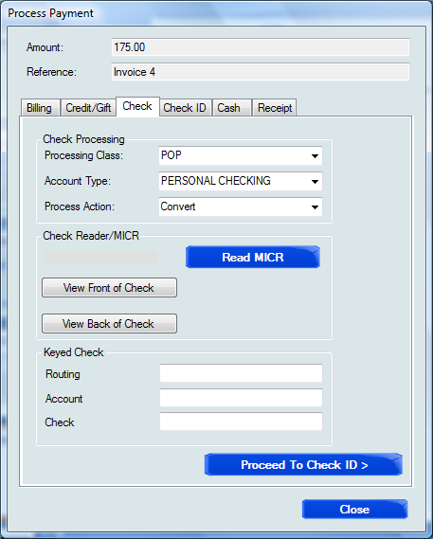
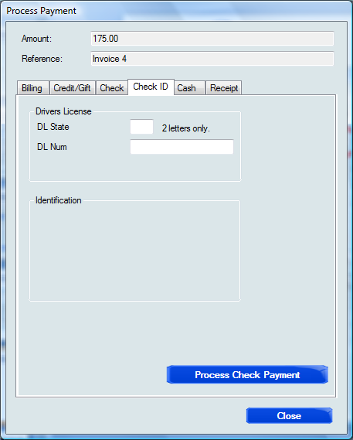
ePNPlugIn: Receive Payment
Manually key
Scan check MICR
Scan check image

Slide 15
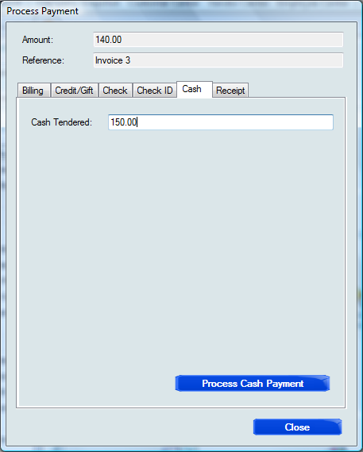
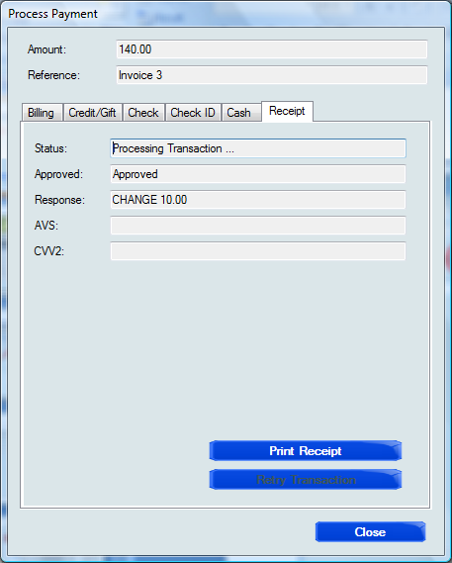
ePNPlugIn: Receive Payment

Slide 16



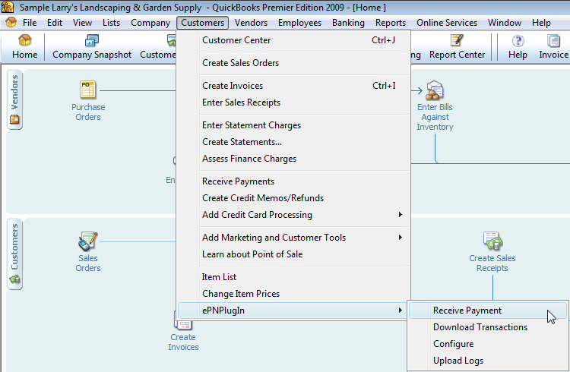

Quotable: “Batch downloads save 2 hours each week over manual updating of transactions.”
*QB Merchant Service User Study, 2004
Download Transactions from the ePN gateway into QuickBooks!
ePN Gateway

Slide 17
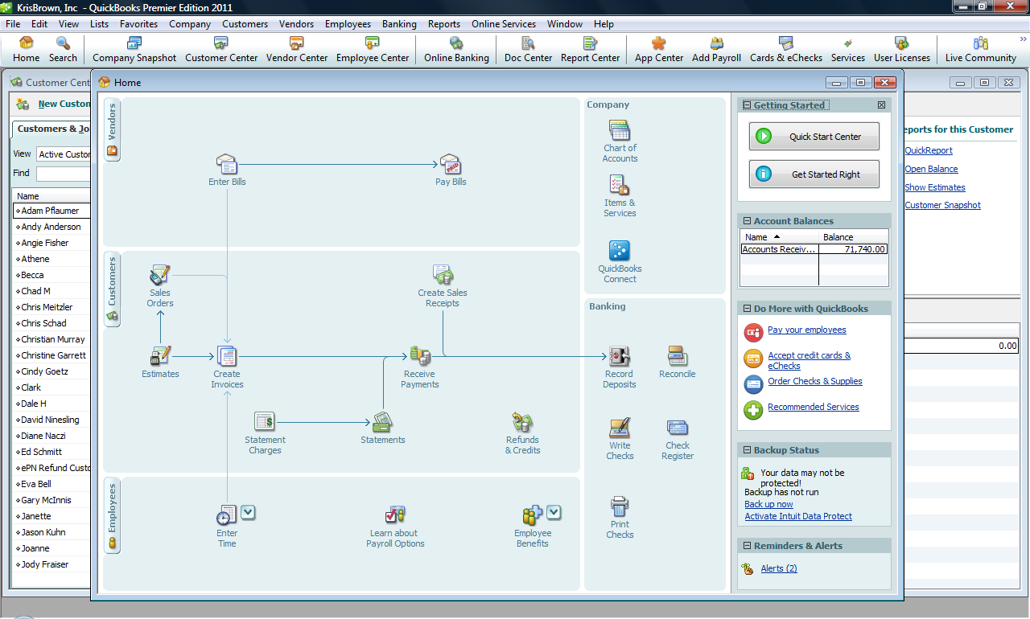
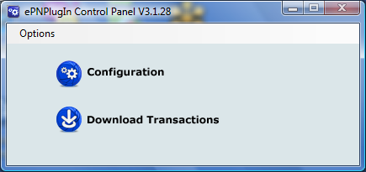
ePNPlugIn: Download Transactions
From the ePNPlugIn Control Panel…
Select “Download Transactions”

Slide 18
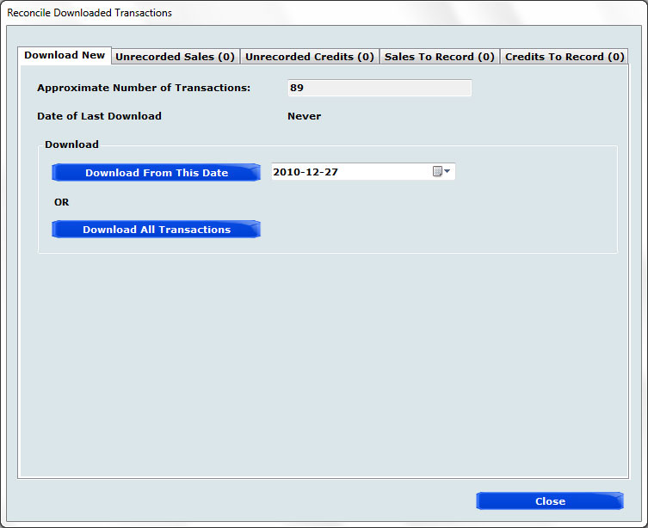
ePNPlugIn: Download Transactions
1st window shows the number of transactions and lets you specify:
1) a specific date or 2) ALL

Slide 19
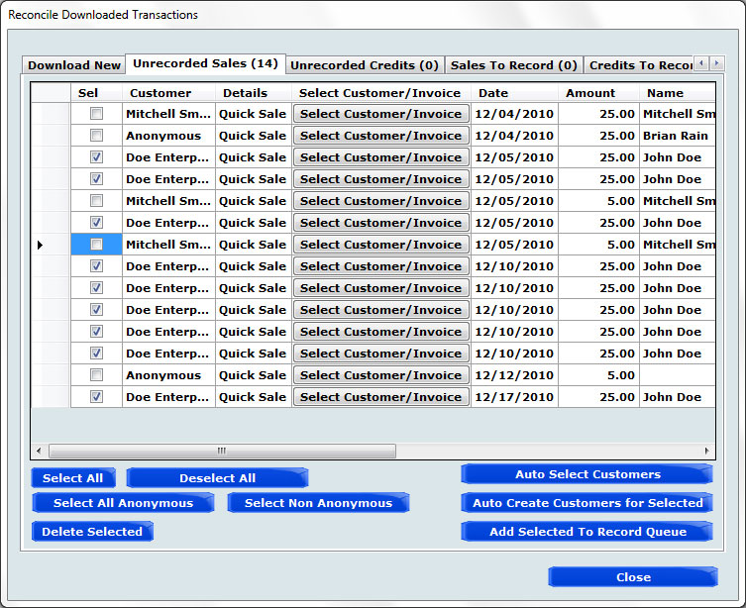
After trans have been downloaded, they must be recorded, i.e. matched with a customer’s invoice.
“Anonymous” means there is not a corresponding QB customer record.
NEW: Auto Create Customers for Selected. This creates a QB customer record – great for online sales from new customers.

Slide 20
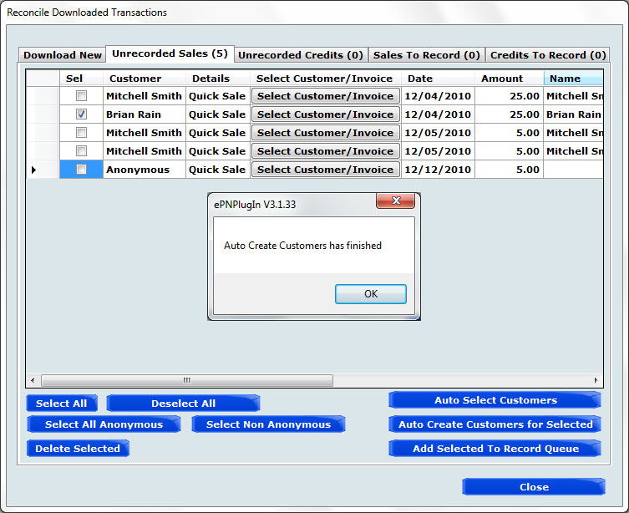
Auto Create Customers used to create new customer records in QB. Copies name, address, etc. from transaction record.
Great for eCommerce merchants!

Slide 21
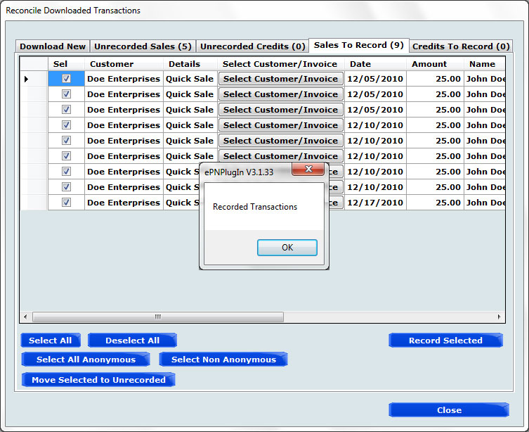
ePNPlugIn: Download Transactions
Sales To Record shows transactions ready to be posted to QB.

Slide 22

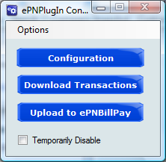
ePNPlugIn w/ ePNBillPay
From Control Panel, select “Upload to ePNBillPay”

Slide 23
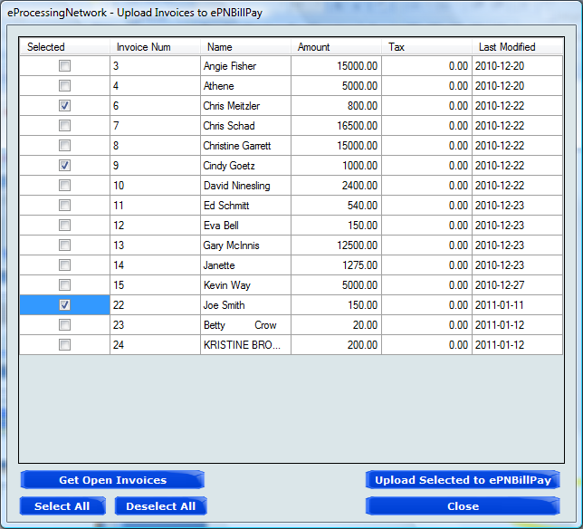
ePNPlugIn w/ ePNBillPay
Select “Get Open Invoices” to display QB invoices yet unpaid
2. Select “Upload Selected to ePNBillPay” for the ones you wish to email to customers

Slide 24
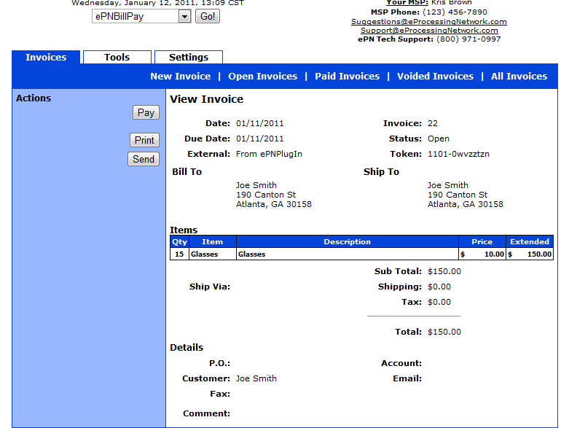
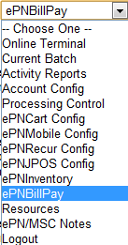
Merchant logs into Merchant Support Center and selects ePNBillPay from dropdown menu
Select Invoice(s) to email to customer(s)
ePNPlugIn w/ ePNBillPay

Slide 25
Send Invoice – Customer Example
You are receiving this email as a notice of an Invoice available for online payment, on behalf of Merchant ABC.
To View and/or Pay this invoice, please click the following link:
https://www.eProcessingNetwork.com/cgi-bin/wo/billpay.pl?a=1210585&t=1012-tib9h232
If you have questions, please contact the Merchant at:
Merchant ABC
1415 North Loop West
Houston, TX 77008
800-971-0997
www.merchantabc.com

Slide 26
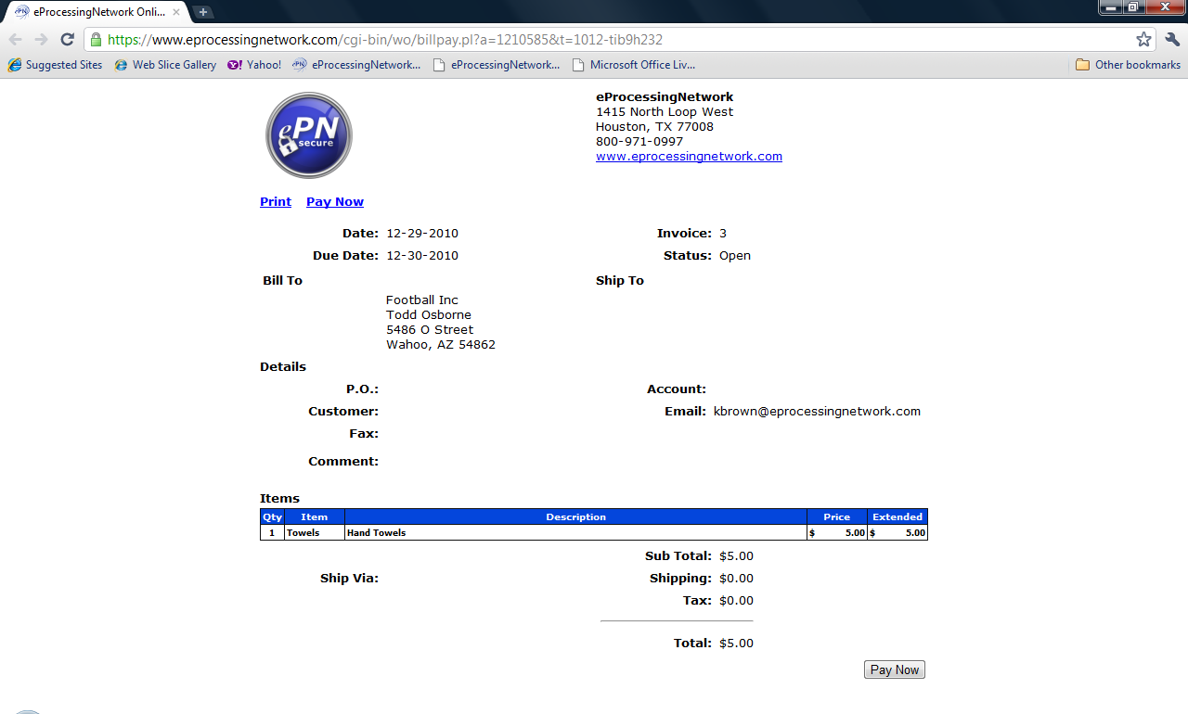
When customer clicks on link…
Merchant’s Logo

Slide 27
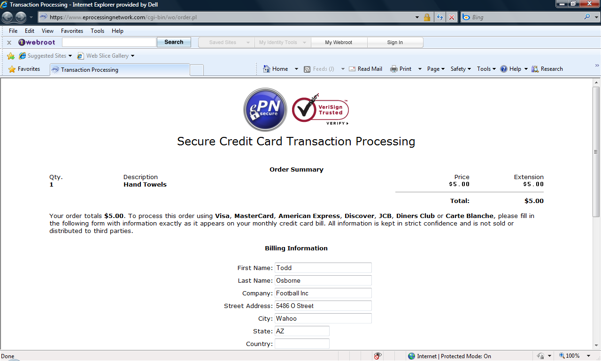
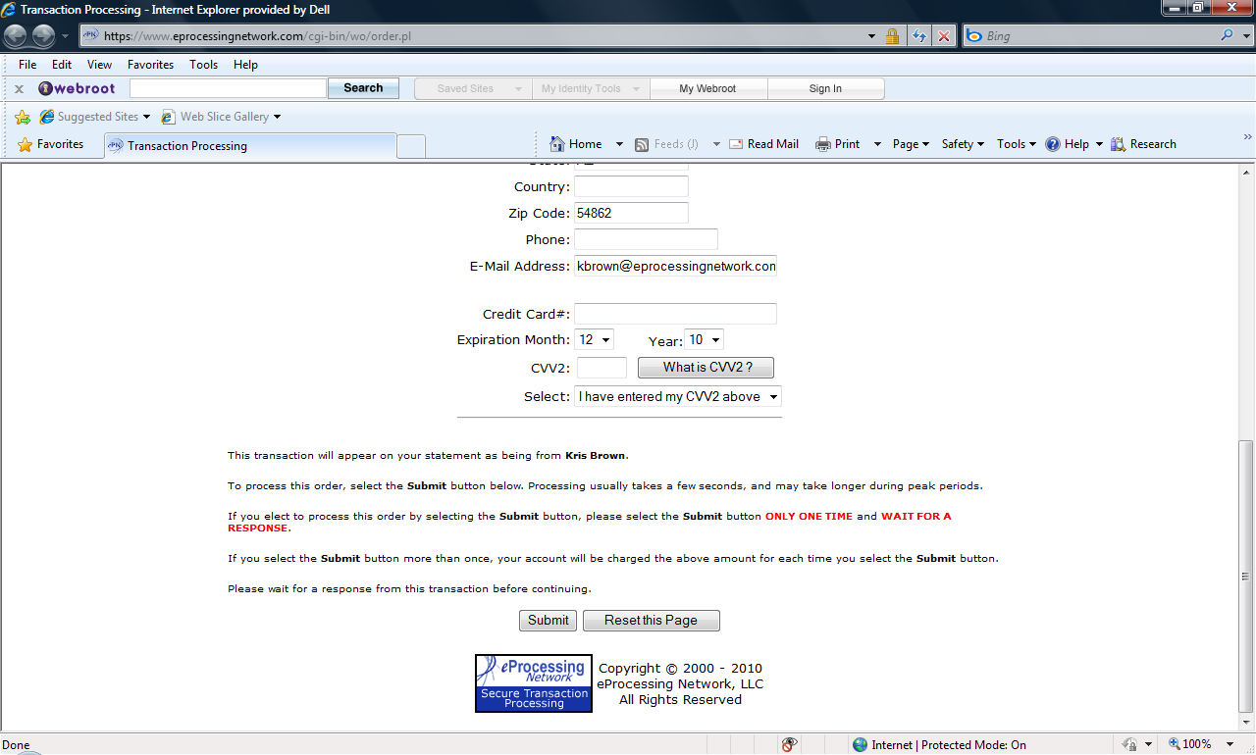

Slide 28
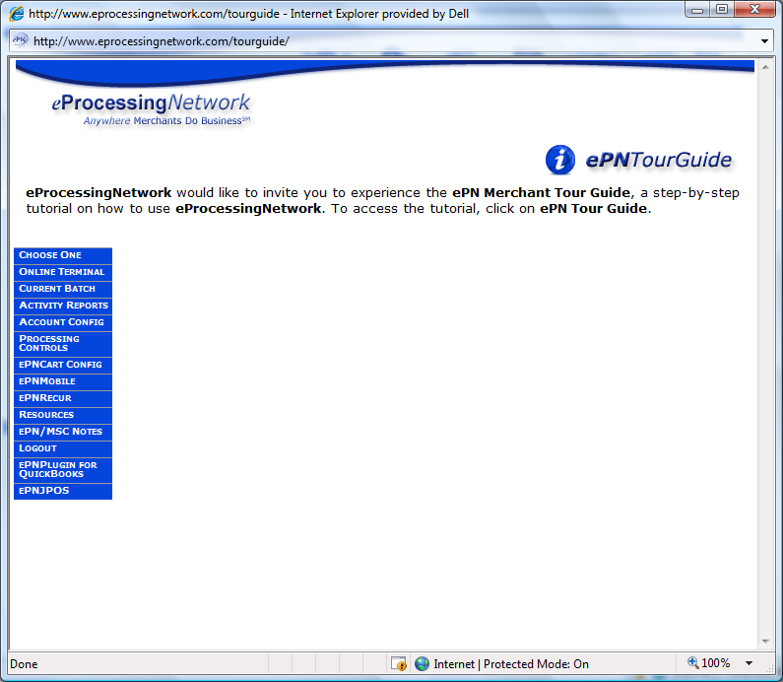
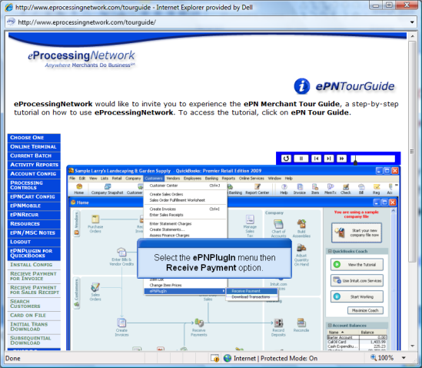
Training & Demos
Reseller Portal
Contains marketing material and product presentations
http://www.epnreseller.com
Tour Guide
Shows application setup and usage
www.eProcessingNetwork.Com/TourGuide.html

Slide 29
QUESTIONS
Kris Brown
Sales Channel Development Manager
800-296-4810, x.152#
kbrown@eProcessingNetwork.Com
Tech Support: 800-971-0997

